Slide 1


Helping Students that Struggle with
Executive Functioning
By Dr. Erica Warren
www.learningtolearn.biz
This presentation is based on the publications:
The Eclectic Learning Profile and Planning, Time Management & Organization for Success: Quick and Easy Approaches to Mastering Executive Functioning Skills for Student

Slide 2


The command and control center of the brain.
The conductor of cognitive skills.
The cognitive process that connects learned experiences with present actions.
The place that encodes, retrieves and manipulates information.
We use Executive Functioning when we perform such activities as:
What is Executive Functioning?
Planning
Organizing
Strategizing
Sustaining attention
Remembering details
Managing time and space
Regulating thoughts and actions

Slide 3
How does Function
Affect Learning?
Making, recalling, & recording plans & assignments
Staying focused in class
Sustaining mental stamina
Keeping materials organized
Showing up to class or appointments on time
Multi-tasking
Turning in assignments
Pairing past and new knowledge
Reflecting on work
Finishing work on time
Thinking through problems
Waiting to speak until called on
Pursuing help
Estimating time to complete a task
I must have no homework… if there is nothing written in my planner!

Slide 4
Just as everyone has their own unique learning style and ways of processing reality, each student also has their own preferences on how to organize their time and belongings. Parents or coaches have their own approach and may try to guide students into organizing in ways that are not beneficial or helpful for that individual. Therefore, considering and accommodating each student’s personal preferences is essential.
But Ms. Williams, my dad organized my binder and that is why I can’t find the homework.

Slide 5
The 12 Learning Styles
Visual Learners
Auditory Learners
Tactile Learners
Kinesthetic Learners
Sequential Learners
Simultaneous Learners
Verbal Learners
Interactive Learners
Indirect Experience Learners
Direct Experience Learners
Reflective/Logical Learners
Rhythmic/Melodic Learners
As defined in the Eclectic Learning Profile, By Erica Warren

Slide 6

Visual Organizers
When your kid’s room is clean and organized, take a picture of it. Use this as a guide.
Help your child create a visual map of how they want to organize their belongings.
Label drawers, boxes, shelves, cubbies and files so it’s easy to see where possessions belong.
Color code and label materials so it is easy to locate things.
Help your child use a color coded planner with designated areas for each class or activity.
Create daily, weekly, and/or monthly calendars to record chores, schoolwork, appointments and other events. If you have more than one child/adult in the household, color-code them.
Show your child how to be organized.
Go shopping to places like a container store, and help your child pick out items that will help them sort, arrange and store belongings.
"A picture is worth a thousand words" - Adage

Slide 7

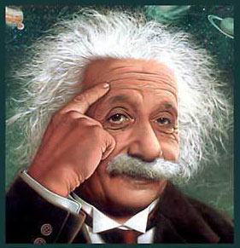
Albert Einstein was a visual learner.
He once said,
“If I can’t picture it, I can’t understand it.”
E=MC²

Slide 8

Auditory Organizers
Give your child verbal cues or directions on how to become and stay organized.
Provide verbal reminders.
Use watch alarms and hand-held devices that offer auditory reminders about important tasks.

Slide 9



Tactile & Kinesthetic
Organizers
Tactile
Let your child organize his or her things, as tactile learners will recall where they were placed.
Consider a palm pilot or handheld organization device.
Encourage lists and drawn plans.
Kinesthetic
Encourage movement while organizing things. Let kids work on tasks such as picking up items around the room. You can always turn it into a game.
If your child get restless, let them take breaks which will allow them to exert some energy.
My room might look like a mess, but I know exactly where everything is!

Slide 10
Sequential & Simultaneous Organizers
Sequential
Encourage organizing materials in alphabetical order. This can be done using a file cabinet, shelves or cubbies.
Create a list of steps that will help your child get organized.
Create a daily routine that sequences activities.
Simultaneous
Clump similar things - this can be done with clear boxes or colored files.
Get a large, “month at a glance” calendar and fill in important dates.
Create a map or drawing of your expectations so that your child can see “the big picture.”

Slide 11
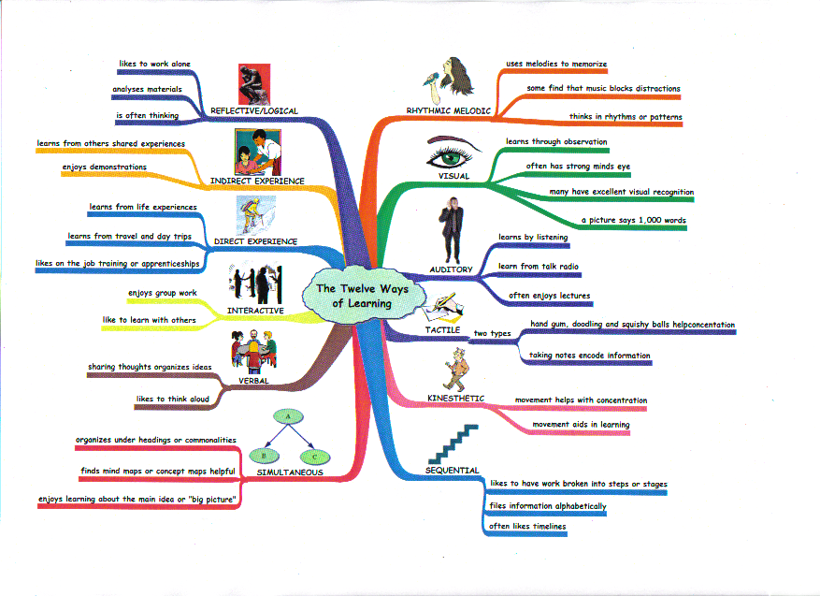
A simultaneous presentation allows one to see the “big picture.”
Created using Inspiration software: www.inspiration.com 12 Ways of Learning: as defined in the Eclectic Learning Profile

Slide 12


Verbal & Interactive
Organizers
Verbal
Encourage your child to verbalize ideas or plans with a friend.
Encourage your child to plan organizational strategies aloud with a family member.
Have family meetings where organizational expectations and issues are shared and all members can brainstorm ideas.
Interactive
Organize with your child. You can help them get organized, and they can help you.
Let your kid shop for organizational materials with a friend.
Let your child organize with a friend.
Encourage your child to learn from friends about how they get organized.

Slide 13

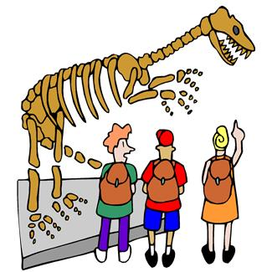
Indirect & Direct
Organizers
Indirect
Demonstrate for your child how you organize your own possessions.
Demonstrate for your child how they need to organize their own belongings.
Encourage your child to learn from someone who is organized.
Direct
Encourage your child to always organize their own things with or without guidance. It is important that they organize themselves.
Encourage your child to develop a routine and organize daily.

Slide 14

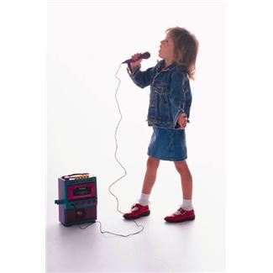
Logical/Reflective & Rhythmic/Melodic Organizers
Logical / Reflective
Encourage your child to think about how they want to organize their things/materials.
Ask your child if they have brainstormed a plan.
Rhythmic / Melodic
Play upbeat music when organizing.
Identify the music best suited for organizing such as calming classical or upbeat pop.

Slide 15
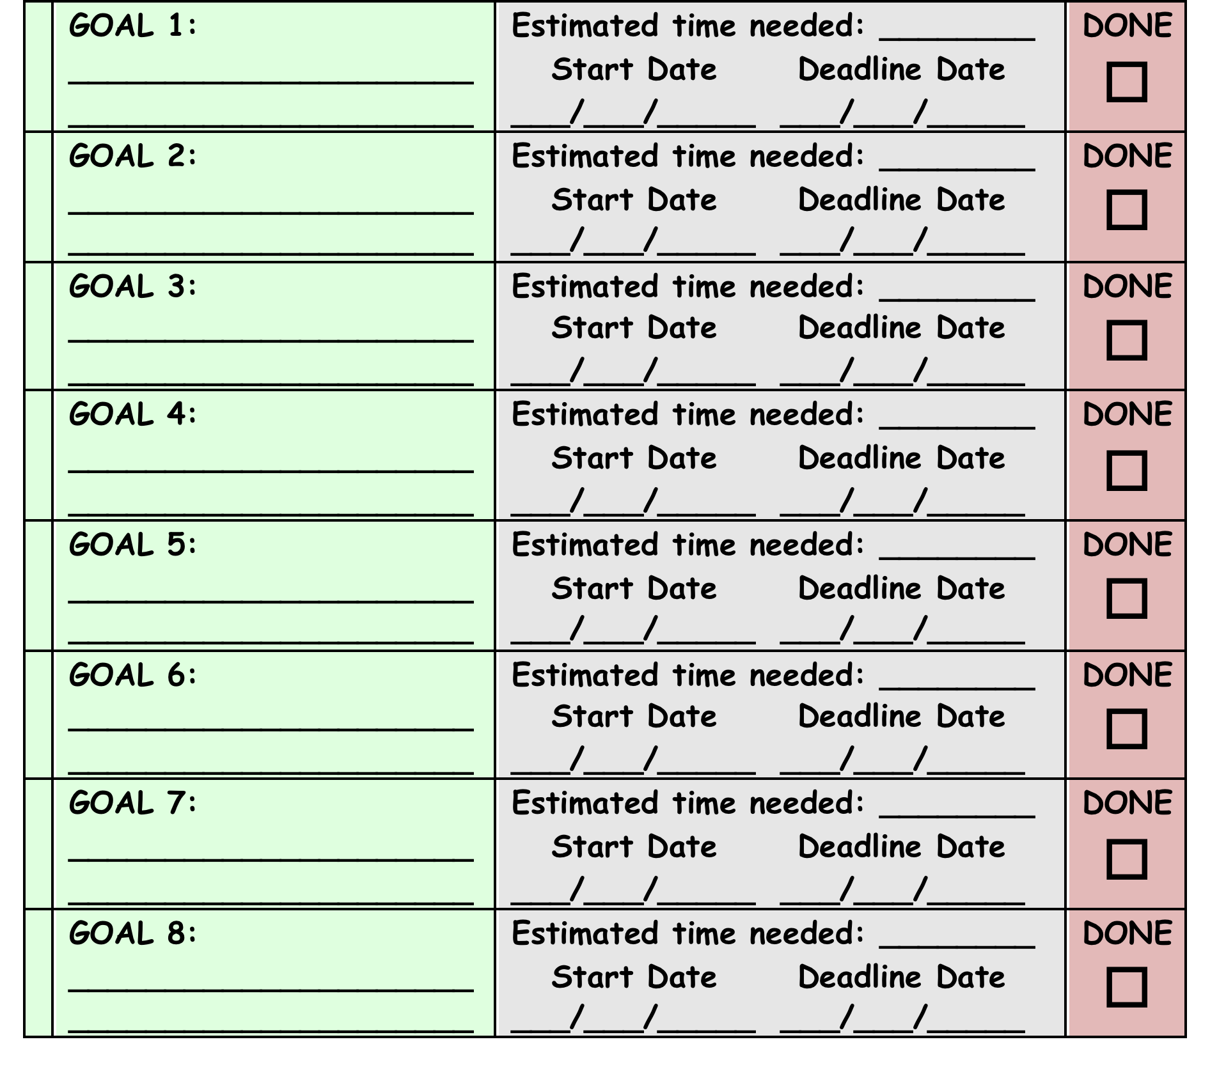
Sample Strategy #1
Break complex tasks into manageable goals.
Define the estimated time needed for each goal.
Define the starting time and deadline for each goal.
Record when goals are reached.

Slide 16
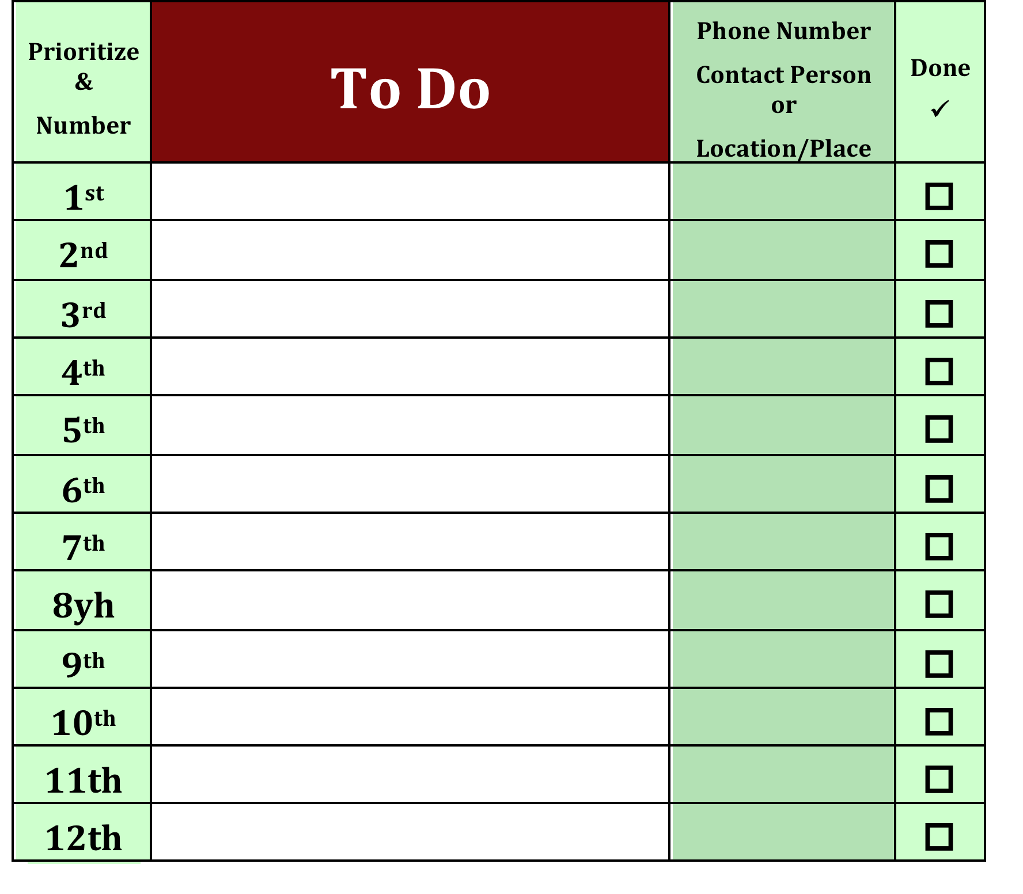
Sample Strategy #2
Sequenced checklists can help kids remember what they have to do.
If your kids are very visual include images of each task.
Checkboxes can be used to record the completion of a task.

Slide 17
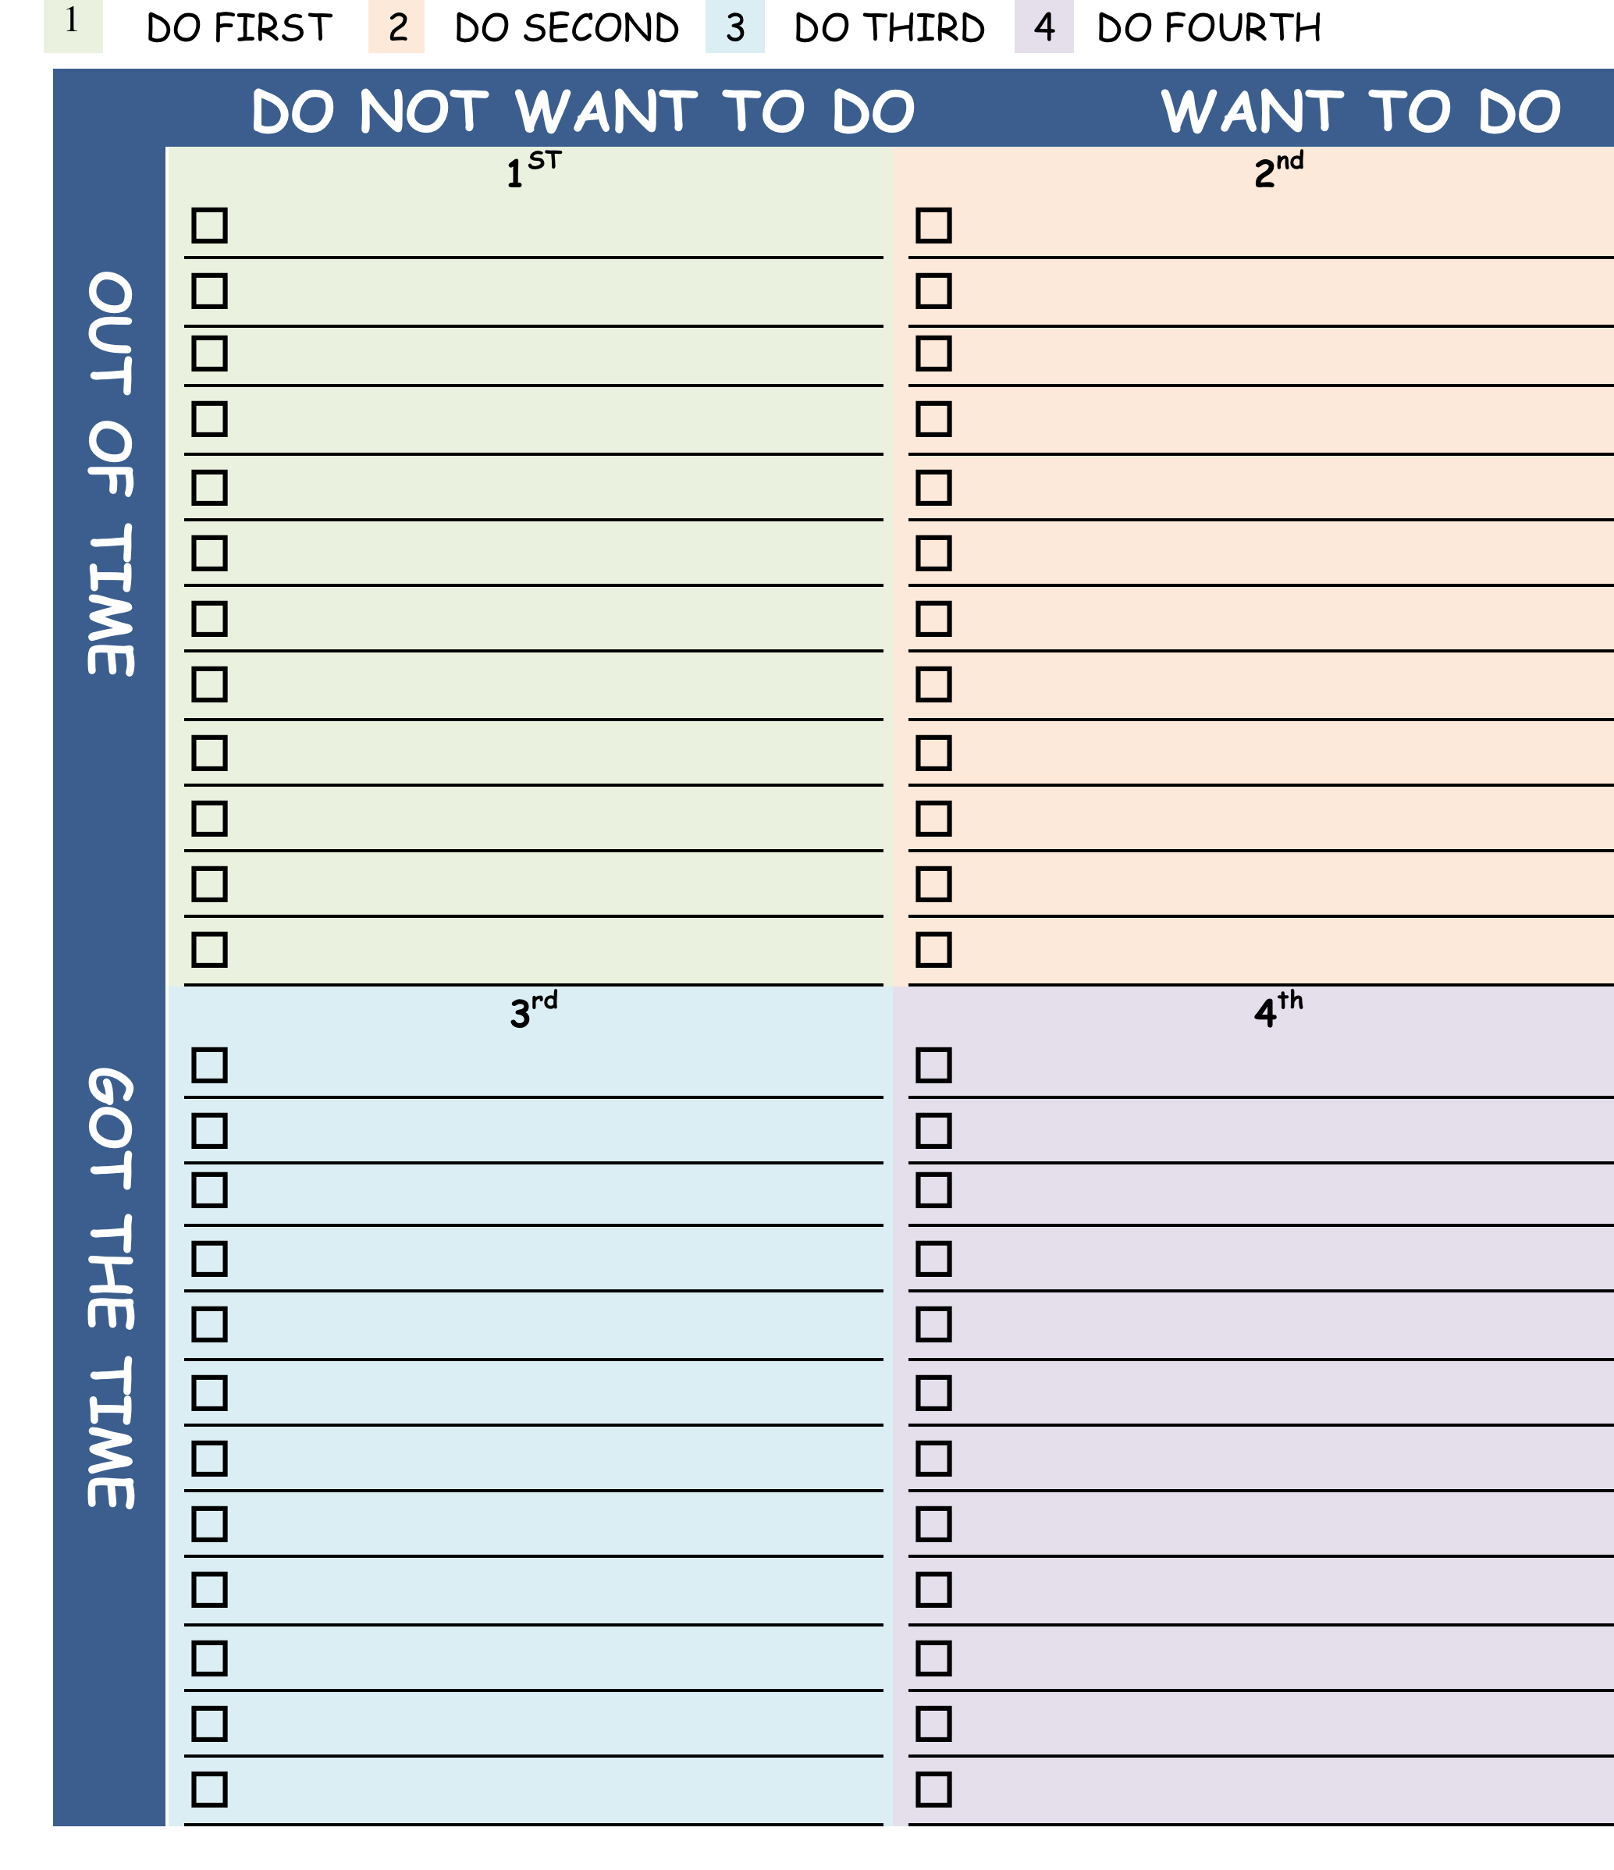
Sample Strategy #3
Using Stephen Covey’s Quadrant System, students can prioritize their time and get more done.
When making a “to do” list, place the tasks under the appropriate heading.
Number the tasks under each heading to determine the order of completion.

Slide 18

All Learners
Create a structured schedule with clear goals and expectations.
Teach your children how to organize, manage time and plan.
Prioritize tasks.
Be consistent – plan a routine.
Practice what your preach - set an example.
Now where did I put my “to do” list?
All this homework is getting in the way of my Facebook time!

Slide 19
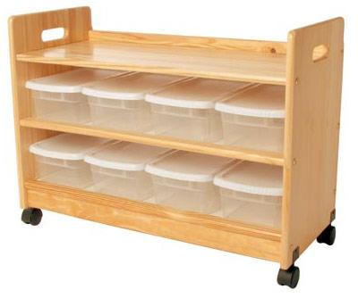
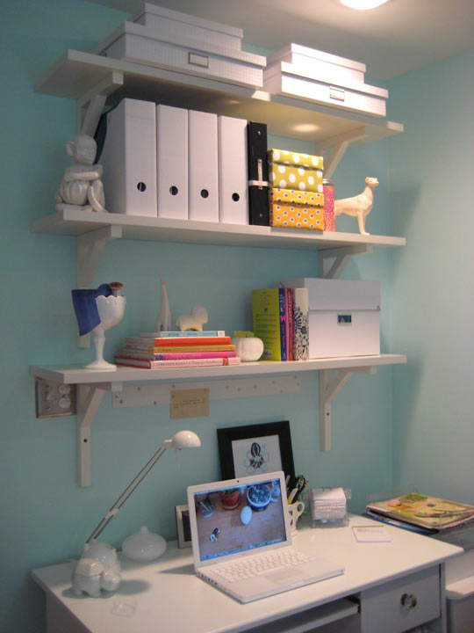
Organizing Space & Materials
Minimize clutter.
Consider having separate work areas for family members with a complete set of supplies.
Schedule a weekly time to clean and organize shared spaces.
Schedule a time, weekly, to clear off desks, organize book bags and file materials. You can use labeled boxes or cubbies, clear boxes or a file cabinet with color coded files.

Slide 20
Take Control
Just do it
Set limits
Hold onto your power
Create rules
Hold your children accountable
Minimize distractions
Only reward appropriate behaviors
Mom! Quit nagging me to do homework! I’ll text you an excuse later.
"If you think you can or think you can't, you're right." Henry Ford.

Slide 21
Manage Behaviors and Remember:
It’s all in your presentation.
Don’t ignore the problem.
It’s not their fault.
Negative labels such as stupid or lazy will cause damage.
If it is easy for you, it doesn’t mean that it is easy for them.
There is no such thing as careless mistakes.
Use positive reinforcement over negative reinforcement.

Slide 22
Incentives Programs
With an incentives program, students can earn points for completing activities, tasks or exhibiting appropriate behaviors. Points are recorded which can then be “cashed in” for rewards. Small rewards can be earned in a day, whereas larger rewards may take weeks or even months.
Let your children earn rewards.
Be prepared and enthusiastic.
Include all individuals involved when designing an incentives program.
Make sure rewards are attainable in a reasonable amount of time.
Make sure your incentives program is monitored daily.
Understand that this approach will help children develop a sound work ethic.
Understand that children value and take better care of belongings that are earned.

Slide 23
Create a Wish List
I wish ____Ben______ would ____put his clothes in the hamper_________
I wish ____Ben______ would ____self-initiate his homework_____________
I wish ____Ben______ would ____make eye contact while in conversation_
I wish ____Ben______ would ____feed the dog___________________________
I wish ____Ben______ would ___limit his time on the computer_________
I wish ____Ben______ would ____get out of bed in time_________________
I wish ____Ben______ would ____organize his book bag _________________

Slide 24
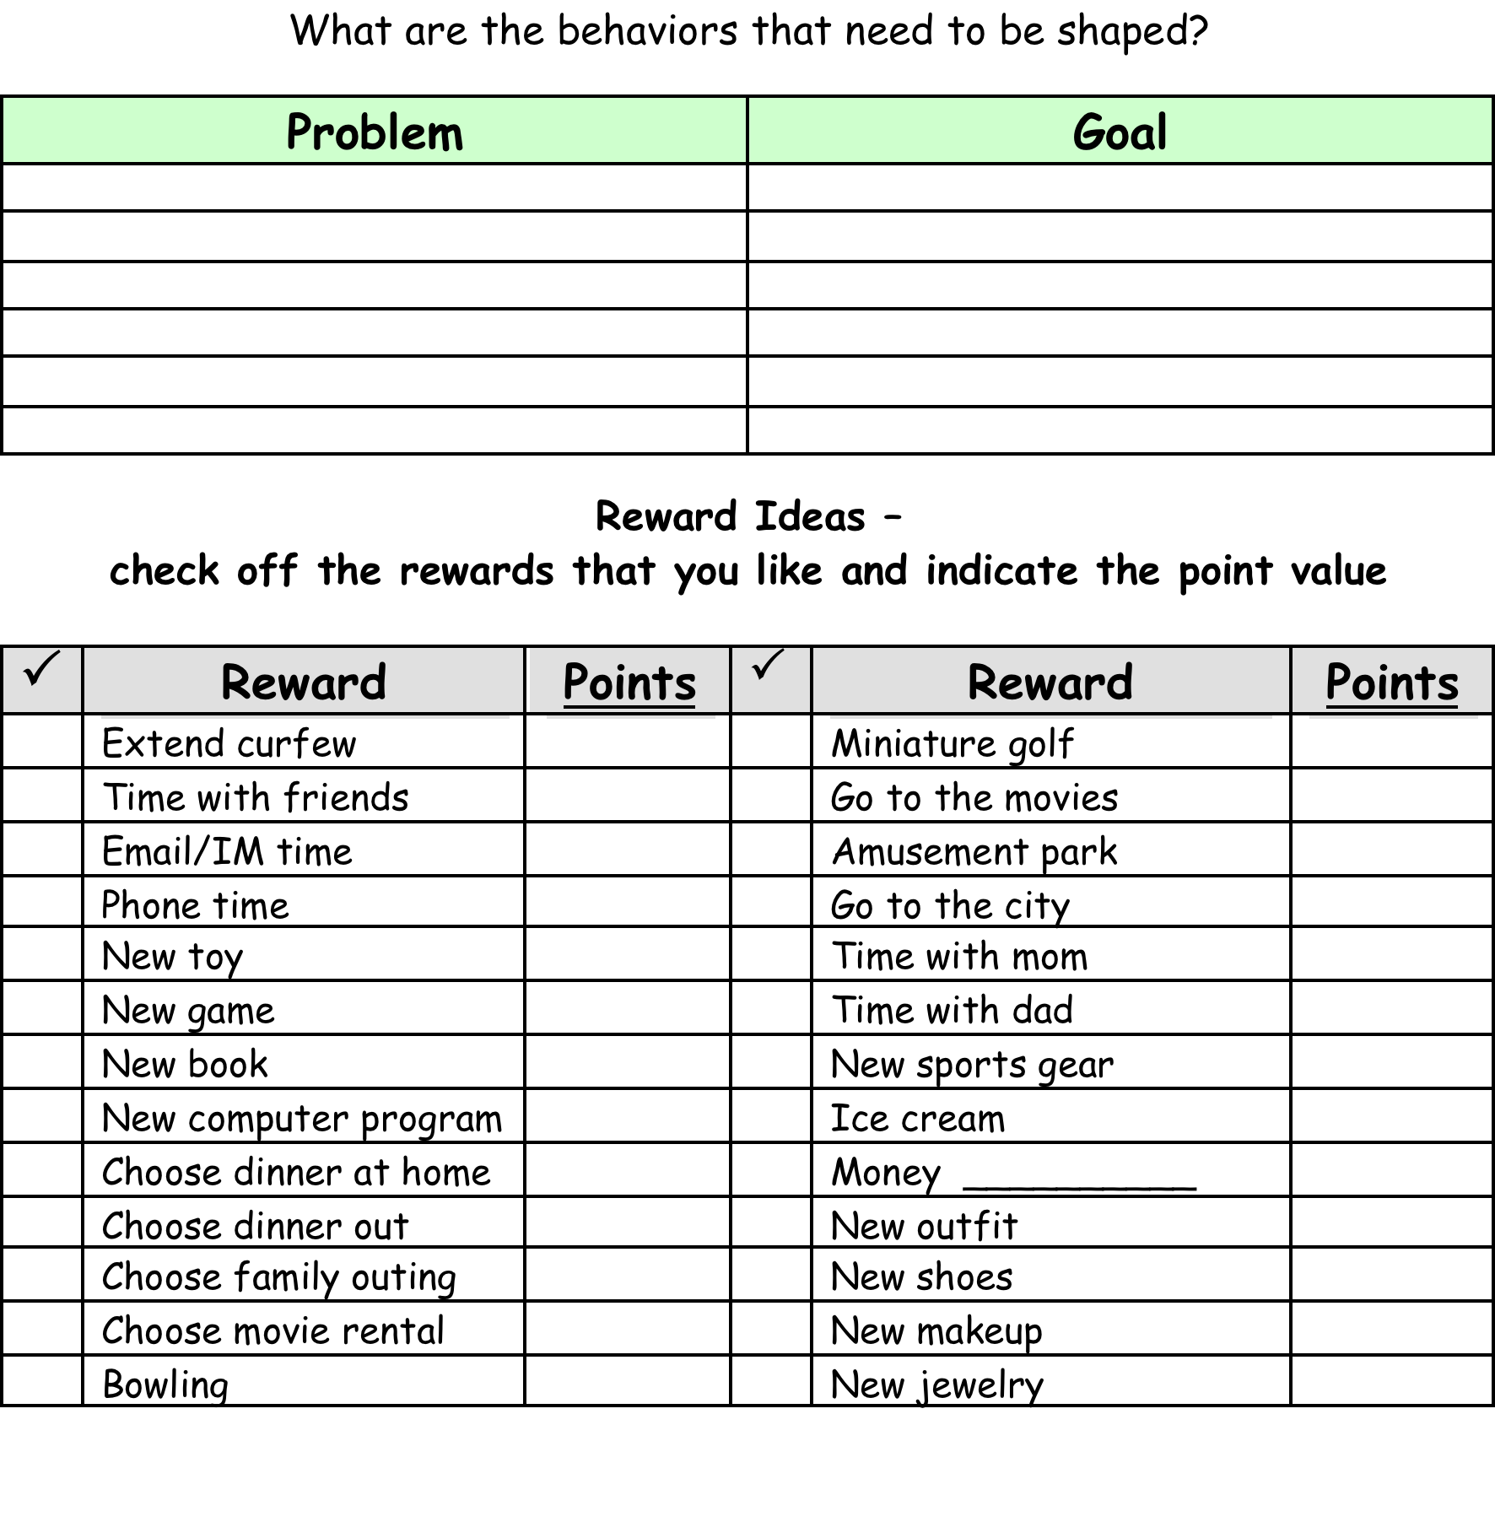
Define Goals & Rewards
Identify the problems
Define goals
Define motivating rewards
Assign rewards a point value

Slide 25
Behaviors to Reward
Define a few “jobs” that address the problem and will meet the goal.
Limit the “jobs” to about 5 tasks.
As goals are reached, substitute with new jobs.
Sam’s jobs
Remember homework materials
Be on time for appointments
Organize room
Brush teeth
Give eye contact

Slide 26
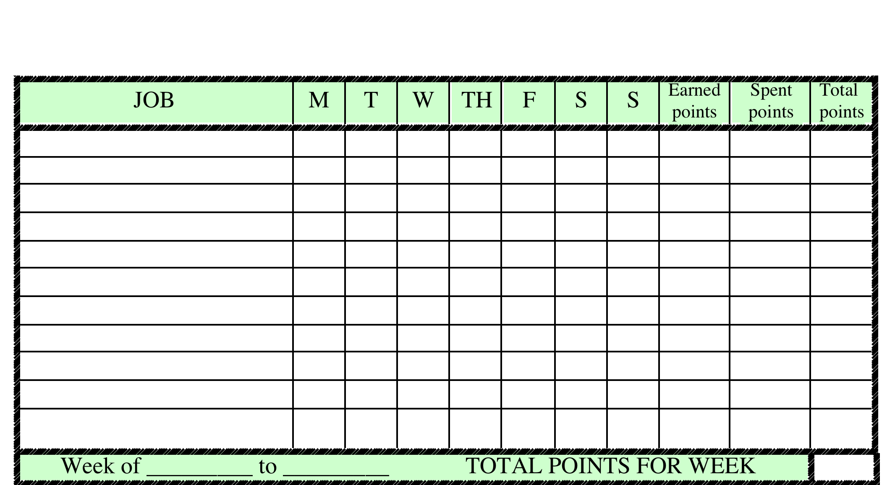
Recording Points
Create a “Job Chart” where points can be recorded daily.
Decide the number of points that each of the “jobs” will earn.
Record daily points.
Once every few weeks, review the tasks and rewards and revise as needed.

Slide 27
Define Child &
Parent Responsibilities
Decide who will be responsible for recording daily completion of tasks.
Define when and how often parents should distribute rewards.
Tweak the system as needed.
As goals are attained decide on additional tasks that will continue to shape desired behaviors in positive ways.

Slide 28
What Else Can I Do?
Planning, Time Management & Organization for Success: Quick and Easy Approaches to Mastering Executive Functioning Skills for Student – This book on CD offers many printable handouts and materials to help with executive functioning skills. http://www.goodsensorylearning.com/Planning,_Time_Management_and_Organization.html
The Eclectic Learning Profile – This book and inventory will help teachers, parents and students maximize potential by uncovering each students best ways of learning. http://www.goodsensorylearning.com/Eclectic_Learning_Profile.html
Dance, Dance Revolution or Dance Central – These games help children with concentration, sequencing and timing.
Interactive Metronome - IM is an assessment and treatment tool used in therapy to improve the neurological processes of motor planning, sequencing, executive functioning and processing.
Lumosity – These are subscription, web-based applications that use a wide range of games and exercises all geared to improve cognitive abilities. www.lumosity.com
Games for the Brain - Free internet games for the brain – www.gamesforthebrain.com
Other fun games that develop executive functioning skills - Blokus, Chess, Set, Mastermind…

Slide 29
Author: Dr. Erica Warren
Learn more at www.learningtolearn.biz
and www.goodsensorylearning.com

